Slide 1
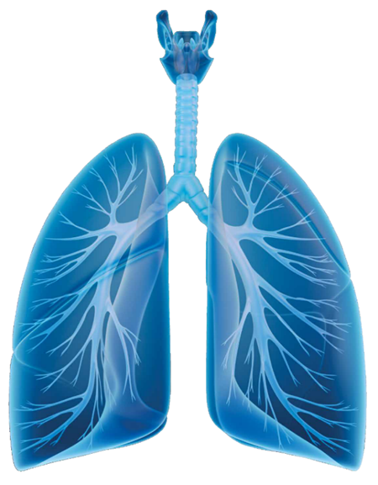
An Overview of MI-E
Sally Cozens
Respiratory Specialist Physiotherapy

Slide 2
Why Assess Cough?

Slide 3


General muscle weakness
Respiratory muscle weakness
Decreased chest
wall compliance
Ineffective cough
REM related
nocturnal hypoventilation
Recurrent chest
infections
Shortening of
respiratory muscles &
Chest wall deformity
NREM and REM
related hypoventilation
Decreased tidal
volumes
Daytime hypercapnic
respiratory failure
Disease Progression
(Chatwin 2012)

Slide 4
Impact Of Impaired Cough
Effective cough is a protective mechanism against respiratory tract infections, which are the commonest cause of hospital admission in patients with respiratory muscle weakness due to neuromuscular disease.
(Chatwin et al 2003)

Slide 5
Impact Of Impaired Cough
90% of episodes of respiratory failure develop because of inability to clear the airways in NMD
(Gomez-Merino et al 2002)

Slide 6
Cough Assessment

Slide 7
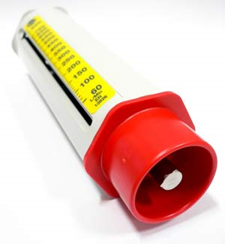
Cough Assessment – How ?
Assessing PCF is a quick and easy way of measuring expiratory muscle function
The greater the PCF, the less risk of respiratory complications (Kang & Bach 2000

Slide 8
Implications of Reduced PCF
Recurrent chest infections
Risk of aspiration
Hospital Admissions
Reduced QoL
Respiratory Failure & Mortality

Slide 9
Which Patients May Be At Risk?
At risk patients not currently on HMV
Patients ventilated via a trache
Patients currently on HMV
(Canadian HMV Guidelines 2011)

Slide 10
An introduction to MI-E

Slide 11
When To Introduce Methods
PCF <270 l min Select MAC or MIC techniques
PCF < 245 l min Combine MAC and MIC
PCF < 160 l min MI- E
Consider MI-E with MAC
Chatwin 2009

Slide 12
Which Patients Are Appropriate?
The NIPPY Clearway is typically used in neuromuscular disease, including the following patient groups;
• ALS
• Post Polio Syndrome
• Spinal Cord Injuries
• Duchenne Muscular Dystrophy
• Spinal Muscular Atrophy

Slide 13
Outcomes of MI-E
Assisting secretion mobilisation
Lung volume recruitment
Increasing inspiratory and expiratory force
Cough augmentation
Reduced Chest Infections… Reduced Admissions
Reduced Cost of Care … Improved QoL

Slide 14
Contraindications to MI-E
• Patients with a history or risk of bullous emphysema
• Patients who have or are susceptible to pneumothorax or pneumo-mediastinum
• Patients with cardiovascular instability
• Patients with tracheoesophageal fistula
• Recent or existing barotrauma
• Spinal instability
• Acute pulmonary oedema
• Acute lung injury
• Facial Trauma

